Slide 1
EW200
Introduction to Programming and Design

Slide 2

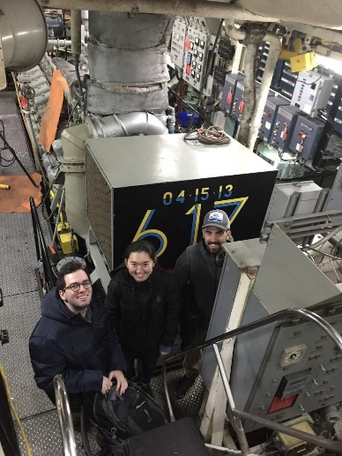
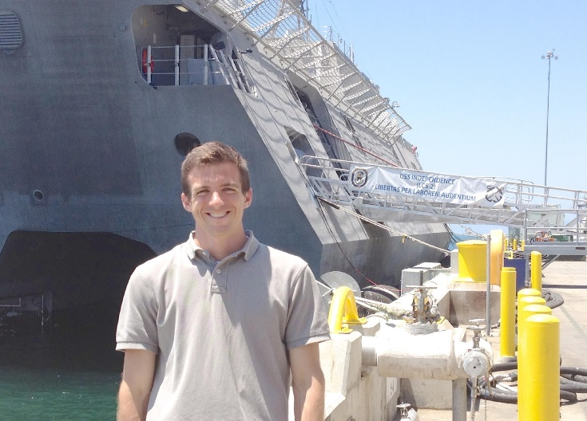
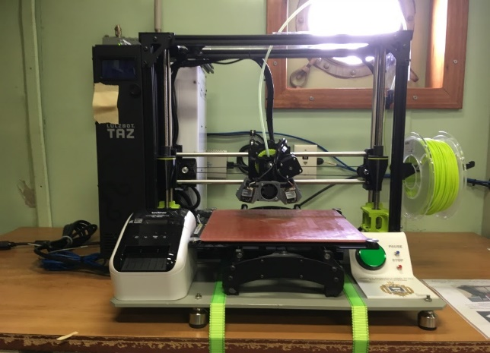
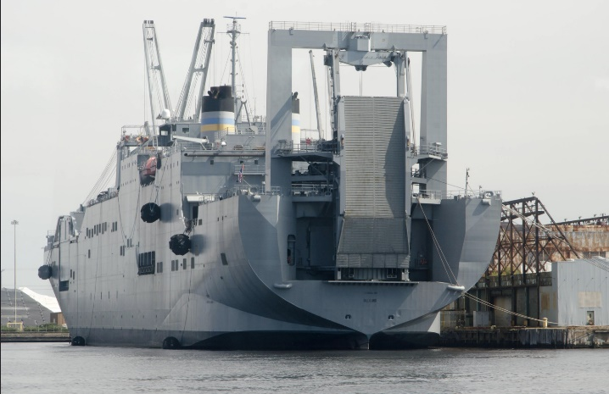


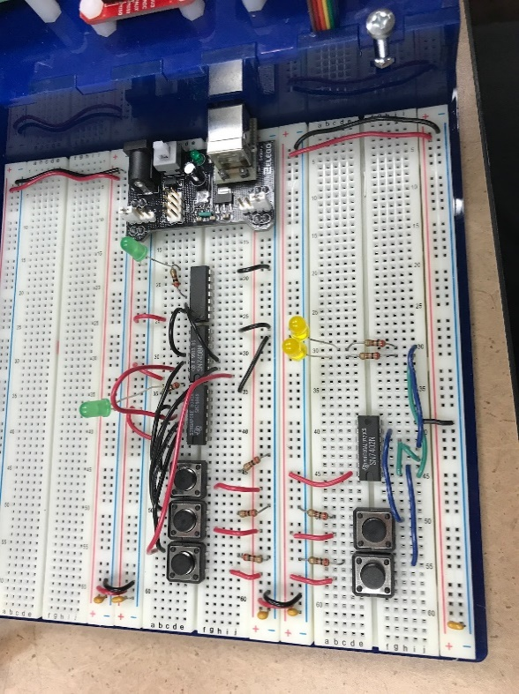

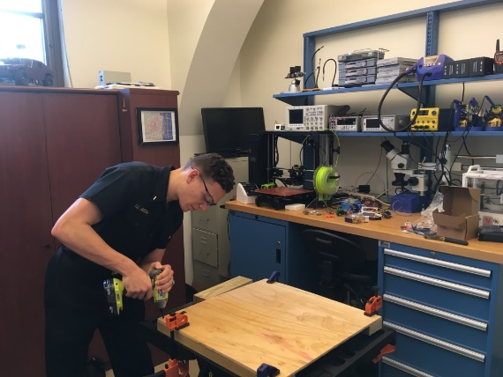
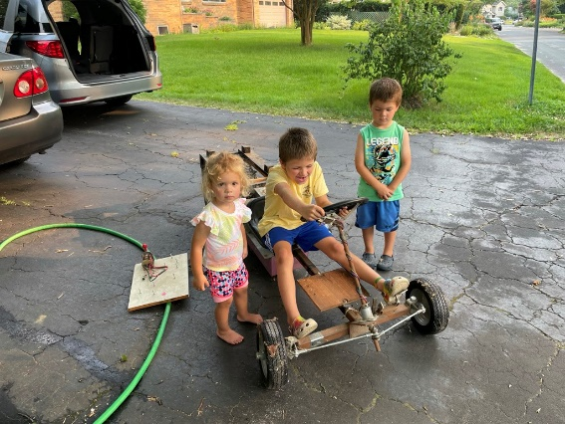
B.S.E. Princeton University
Electrical Engineering
US. Army: 50th Signal Battalion
Platoon Leader
Director of Network Plans and Projects OIF
Ph.D. Massachusetts Institute of Technology
Electrical Engineering

Slide 3
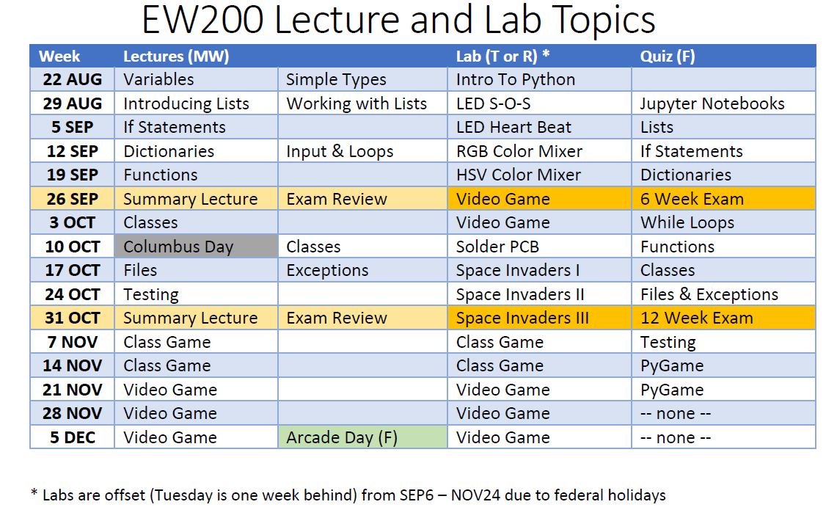
Admin Material
Roll
Syllabus
Course Policy

Slide 4
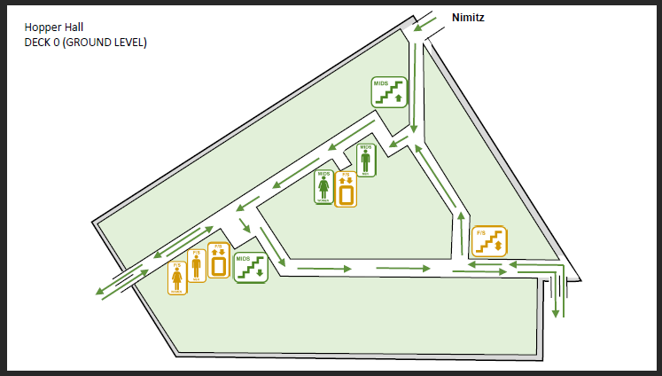
Know Your Way Around Hopper Hall
Coffee bar
HP017
TSD
Aerial Vehicles
Surface / Underwater Vehicles

Slide 5
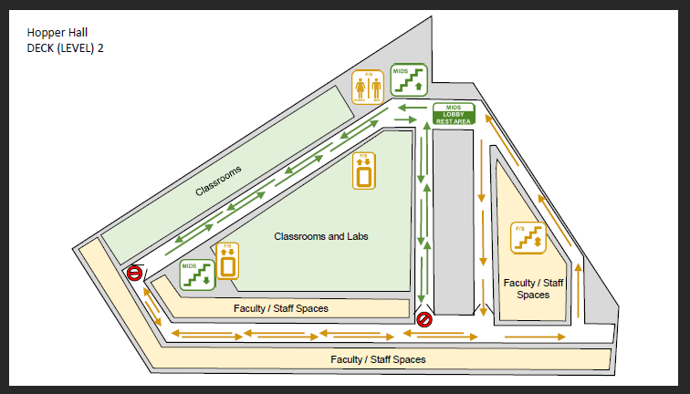
Know Your Way Around Hopper Hall
WRC
Dept.
Office
269
223
My office

Slide 6

EW200 Textbook
Python Crash Course (2nd Ed) by Eric Matthes
Amazon Link
A physical copy of the book is required.
Book Check this Friday (Quiz 0)
Notes:
Amazon offering $19.47 gift card for 7th edition of Dietel
Can rent paperback versions from Amazon for $39 & $23.45 respectively

Slide 7



EW200: Software
Install from Anaconda and Mu from Software Center before next class
Anaconda provides a Python Environment for your Laptop
Jupyter Notebooks allow you to run Python code interactively
Mu allows you to run Python code on a microcontroller (Pico)

Slide 8
Google Classroom
See Google Classroom for:
Basic admin (syllabus, course policy, etc.)
HW assignments and solutions
Lab assignments
Lectures

Slide 9
Policy on Collaboration* *see course policy document for full and official details
Robotics & Control Engineering is a community
All out-of-class work can be done collaboratively with these caveats:
You may get assistance from others, but you may not copy their work
You are responsible for all of the skills and techniques utilized on out-of-class work
You may be tested or evaluated individually
You must cite all assistance on each assignment

Slide 10
Devices in the Classroom
You should always be working on EW200 related materials during class
Laptops should be shut (unless you are programming or working on an assignment)
Manage email, your social media presence, your Navy Federal account, and your online bingo games outside of class

Slide 11
What is This Major About?
Autonomous: Robotics & Control Engineers make automated machines
ex. robot, unmanned vehicle, autopilot, smart munitions, automated spacecraft, smart homes, etc.
Interdisciplinary: Use Electrical, Mechanical, and Computer Eng.
sensors + motors + computers = smart devices
Control and Sensing:
A science in their own right. Systems that understand and respond to environment.
Image Processing, Sensor Fusion, System Modeling, etc.

Slide 12
Your Community
Website:
http://intranet.usna.edu/WRC/
Facebook:
Robotics & Control Engineering at the US Naval Academy
https://https://www.facebook.com/Robotics.and.Control.Engineering.at.USNA/

Slide 13
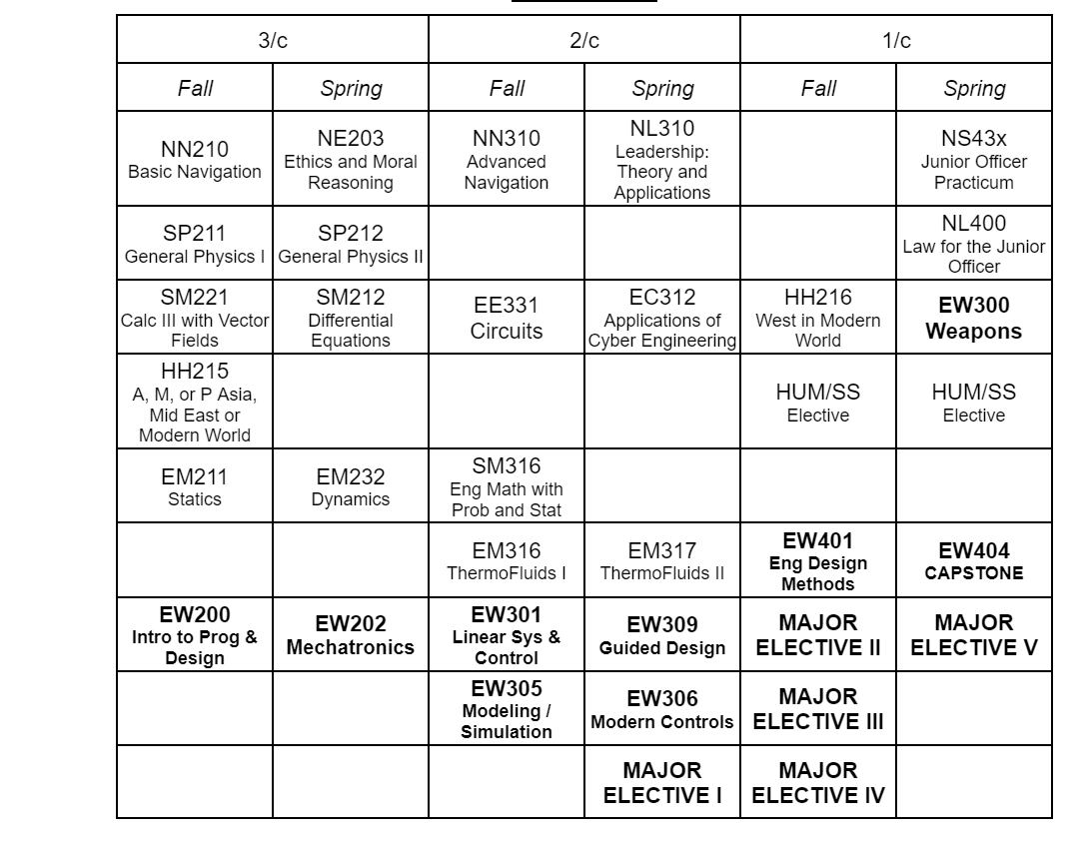
ERC Major
Typical Matrix
Additional Major Elective Courses: EW470 Desktop Manufacturing EW485A Lasers in a Maritime Environment
EW485B Control of Multi-Agent Networks
EW485D Control of Physiological Systems
EW486D Advanced Topics in Naval Weapons
EW486A Data Science & AI for Robotics & Control
EW486F Experimental Implementations for Unmanned Systems
EW495/6 Robotics & Control Engineering Research
Other Offerings and Special Topics:
EW281C “School of Drones” – quadrotors
EW282C “School of Drones” – fixed wing
EW282 Intro to Laser Research
EW481/482/495 Midshipman research & special topics
Major Electives
Estimation & Control EW413 Digital Control Systems EW456 Autonomous Vehicles EW418 Optimal Control and Estimation Cyber Physical Systems EW430 Embedded Systems EW432 Internet of Things Engineering Management EW461 Quantitative Methods for Management EW464 Engineering Economics EW462 Emerging Technologies Robotics (select at least one) EW450 Introduction to Robotic Systems EW456 Autonomous Vehicles EW451 Mobile Robot Design EW452 Advanced Topics in Robotics EW453 Introduction to Computer Vision Signal Processing EE432 Digital Signal Processing EW453 Introduction to Computer Vision

Slide 14

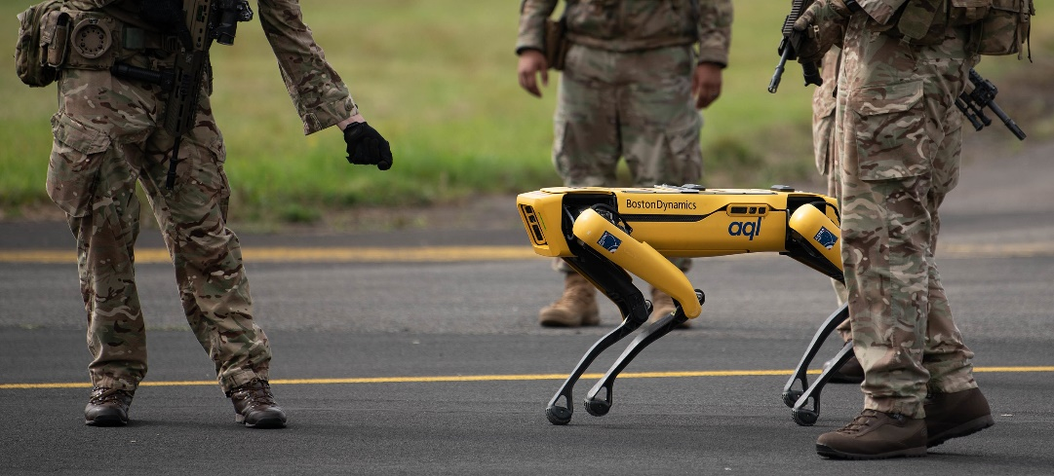
Computer Programming
Programming is like Chess
Understand the Rules Textbook Chapters 1-11
Learn some Strategy Class Video Game- Space Invaders
Play It! Build your own Video Game
Programming is not like Chess
By Alan Light - Own work by the original uploader, CC BY-SA 3.0,
https://commons.wikimedia.org/w/index.php?curid=20299
By Senior Airman John Ennis - https://www.dvidshub.net/image/6806710/technology-integration-agile-liberty-21-2, Public Domain, https://commons.wikimedia.org/w/index.php?curid=112759077

Slide 15
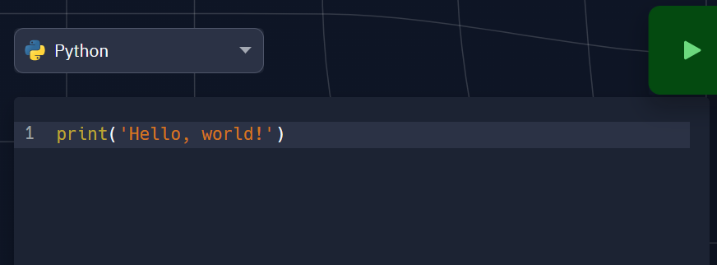
Hello World
Write your first Python Program
https://replit.com/languages/python3
Why Python? Try some of the other languages (Java, C) from the drop down menu…

